Slide 1

Online Bookstore
Write your Name

Slide 2

Introduction
This presentation outlines the key features and functionalities of an online bookstore platform, focusing on user account management and book interaction.

Slide 3

User Account Management
01
Many readers struggle to find an affordable, user-friendly platform to
purchase books online, while local bookstores lack digital reach.

Slide 4

User Registration
The user registration process is designed to be straightforward and user-friendly, allowing users to create accounts easily. Users may register using their email addresses or social media accounts and will be required to provide essential information such as their name and password.

Slide 5
Login Process
The login process ensures secure access to the user’s account. Users can input their credentials to gain access to personalized features such as viewing their order history and managing account settings. The system will also include options for password recovery.

Slide 6
Profile Management
Profile management allows users to update their personal information, manage passwords, and configure preferences for notifications and communications. This feature ensures that users have control over their accounts and can customize their experience according to their needs.

Slide 7

Book Interaction
02
Users can interact with books by viewing details, adding them to cart or wishlist, and leaving ratings or reviews.

Slide 8
Browsing Books
Users can browse a wide selection of books organized by categories such as genres, bestsellers, and new arrivals. Advanced filtering options and search functionalities enhance the user experience, allowing users to find specific titles or authors quickly.

Slide 9
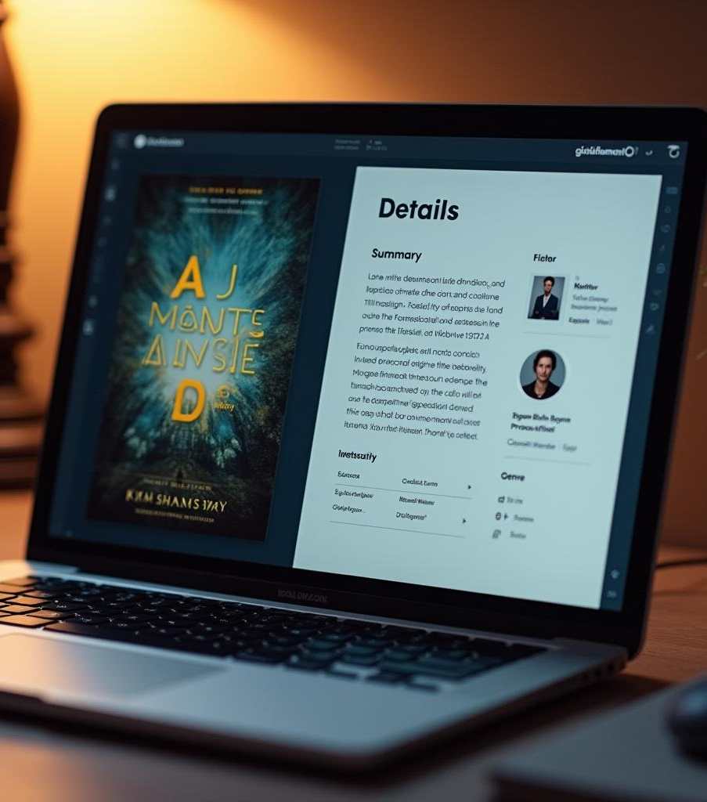
Viewing Book Details
The book details page provides comprehensive information, including the book's summary, cover image, author details, and genre. Additionally, users can view pricing and availability, making it easy to make informed purchasing decisions.

Slide 10
User Reviews
User reviews and ratings are integral to the platform, allowing customers to share their experiences and opinions on books. This feature not only aids other users in their purchasing choices but also fosters a sense of community and engagement among readers.

Slide 11

Conclusions
The online bookstore platform delivers essential features that enhance user experience through streamlined account management and interactive book functionalities. By focusing on user engagement and satisfaction, the platform aims to establish a loyal customer base.

Slide 12
Thank you!
www.yourwebsite.com
Do you have any questions?
+00 000 000 000

